Slide 1
Use case diagrams and Misuse cases

Slide 2
A Library System
“You have been asked to develop a computer system for a college library. The library currently uses a program, written in an obsolete language, for some simple book-keeping tasks, and a card index for browsing. You are asked to build an interactive system which handles both of these aspects online.”
[adapted from Pooley & Stevens]
A bit vague! Needs clarification. Talk to librarian, library members.
Get some first cut use cases based on the potential Actors -
BookBorrowers JournalBorrowers
Browsers Librarians
For each actor, consider:
What do they need from the system ie what use cases would have worth to them
Any other way they might interact with the system, even if it is for someone else’s benefit
(E.g. an accounts dept. sending bills to customers.)

Slide 3
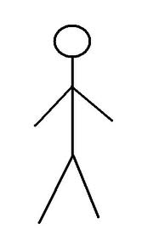
UML – Library use case diagram
Reserve book
Browse
Return book
Borrow book
Extend loan
Browser
Book borrower
Journal borrower
Borrow journal
Update catalogue
Return journal
Librarian

Slide 4
So what is missing/wrong?
What about journals?
Have we considered the following?
Overdue books
Fines and letters
Updating borrower information
Inter-library loans
In particular, Updating the Catalogue cannot be considered a “single function point”.
It could relate to:
Adding new books,
Deleting tatty books,
Finding out publishers and costs for re-ordering,
Finding out borrowing stats to see which books not used, or more copies are required...

Slide 5
Misuse cases
Suggested by Sindre & Opdahl to summarise the possible actions that COULD occur with a system that might cause harm
Could be malicious or accidental
Also includes mitigation use cases to counter the threats
They suggest using a process to elicit security requirements:
Identify critical assets
Define security goals (for each asset)
Identify threats
Identify risks (using standard techniques)
Define security requirements

Slide 6
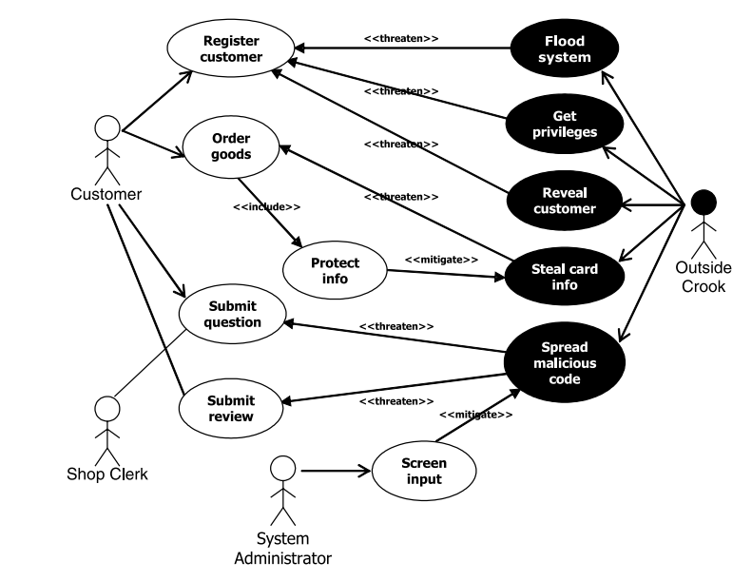
Use and Misuse cases
for an e-store
Example from Ref 5.

Slide 7
Example Use Case with Misuses from Ref. 5
Name: Register customer
Iteration: Filled
Summary: The customer registers for the e-shop, giving name, address, email, and phone
Basic path: bp–1. The customer selects to register
bp–2. The system provides the registration form
bp–3. The customer completes the form and submits
bp–4. The system acknowledges registration, returning a customer reference number
Alternative paths: [...]
Exception paths: E1.In action 3, the customer submits with mandatory information missing.
Return to action 3 to provide more info
E2.In action 3, the submitted info matches an already registered customer.
The system notifies the user that registration is abandoned because the customer is already registered.

Slide 8
Example Use Case with Misuses from Ref. 5 continued
Extension points: [...]
Triggers: [...]
Assumptions: [...]
Preconditions: [...]
Postconditions: The customer is now registered, and will be enabled to order goods from the e-shop without providing contact info anew
Related business rules: [...]
Threats: T1:The customer is not registering with his own name and address, but with an assumed identity. Possible outcomes:
T1–1. A non-existing person is registered as customer
T1–2. An existing person is unwillingly and unknowingly registered as a customer
T1–3. It is revealed to a third party that the named person is a customer of the e-shop (see exception pathE2above)
T2:[...]

Slide 9
Problems with Use Cases
Not always sufficient to extract requirements in enough detail
For example, consider a training simulator
Concentration on use cases can distort design - can lose sight of need for strong architectural design later
Consider library system - could just be a bunch of dialogs directly querying a db or even simpler data structure
Can end up including design in use cases instead of just requirements - tend to think operationally rather than standing back
Consider whether accounts department really need to be issuing the bills rather than direct from the warehouse operation
Here we are talking about business process re-engineering…

Slide 10
References
Browne & Rogich (2001) “An empirical investigation of user requirements elicitation: comparing the effectiveness of prompting techniques” Journal of Management Information Systems 17, 223-249
Browne & Pitts(2004) “Stopping rule use during information search in design problems” Organizational Behavior and Human Decision Processes Volume 95, Issue 2, November 2004, Pages 208-224
Pitts & Browne (2007) “Improving requirements elicitation: an empirical investigation of procedural prompts” Information Systems Journal 17, 89-110
Davey & Cope (2008) “Requirements Elicitation – What’s Missing?” Issues in Informing Science and Information Technology , Vol 5, 2008
Sindre, Opdahl “Eliciting security requirements with misuse cases” Requirements Eng (2005) 10: 34–44

